Slide 1
Downloading Broadwick
Save from web area or copy from usb stick to desktop (or a folder you have created)
Unzip the Broadwick1.zip file

Slide 2
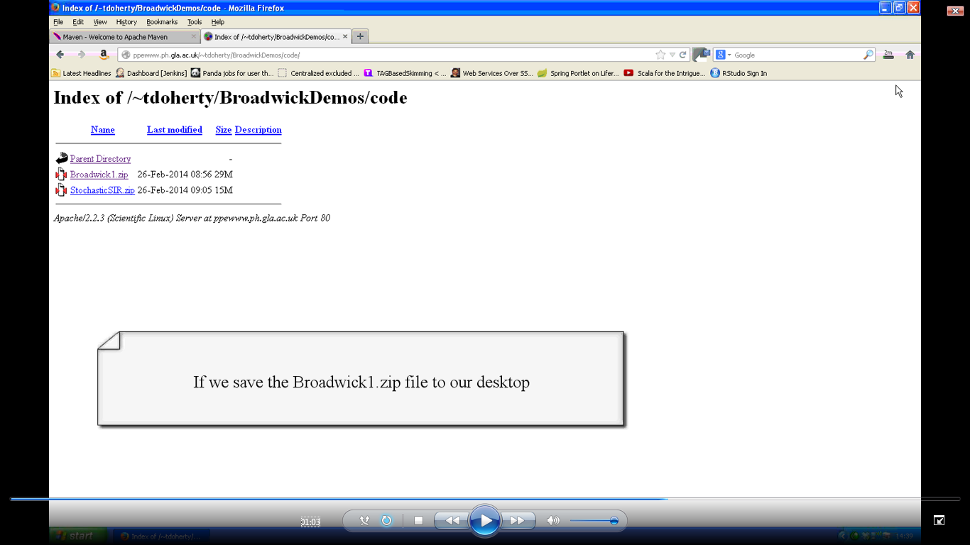

Slide 3


Slide 4
Installing Netbeans
Download Netbeans (with JDK) installation suitable for your operating system from link (or copy from usb stick provided).
Set Java environment variables – see supplemental installation instructions for operating system specific instructions.
Run Netbeans installer and open Netbeans 7.4

Slide 5
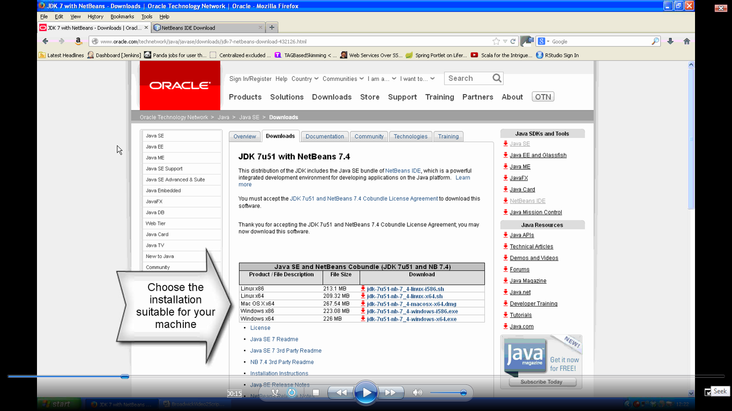

Slide 6
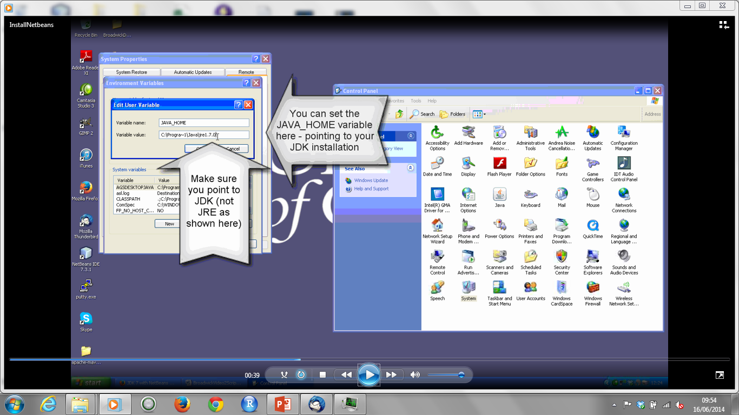

Slide 7
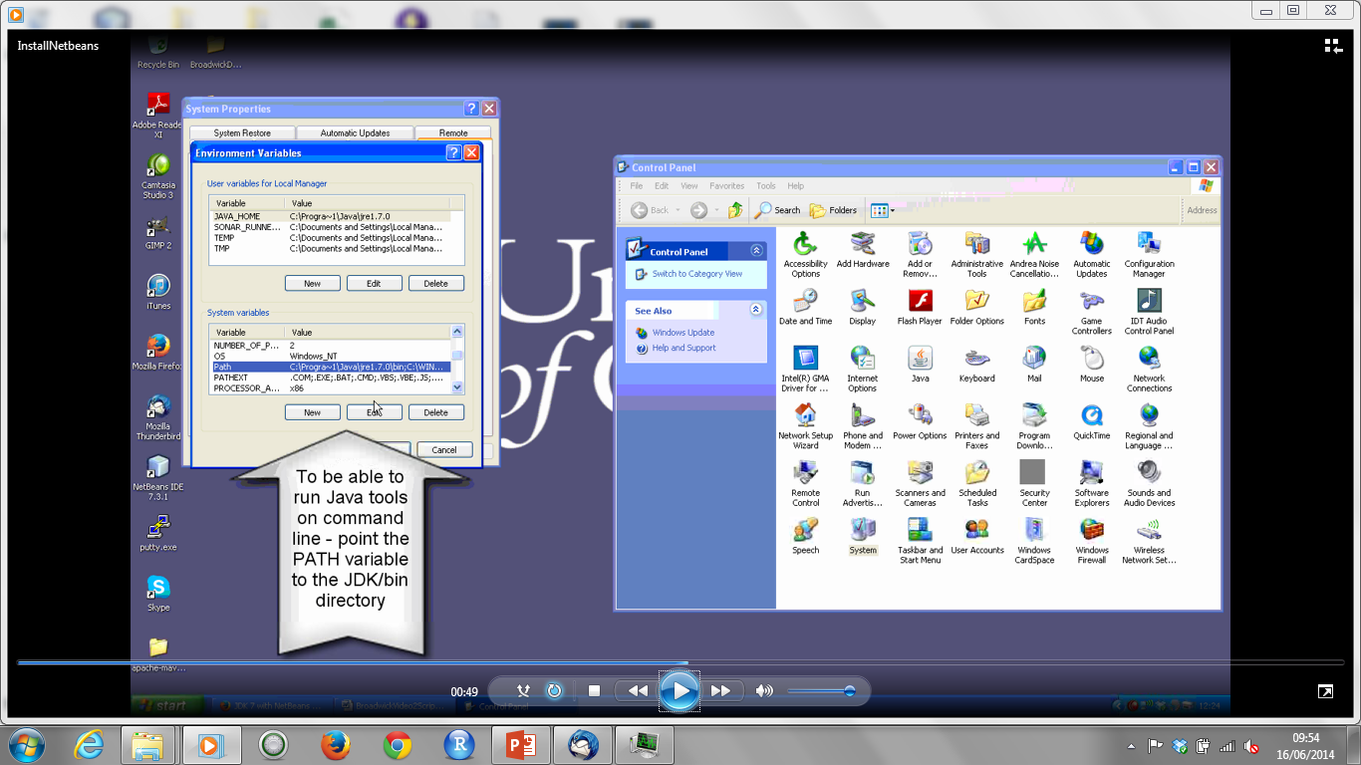

Slide 8
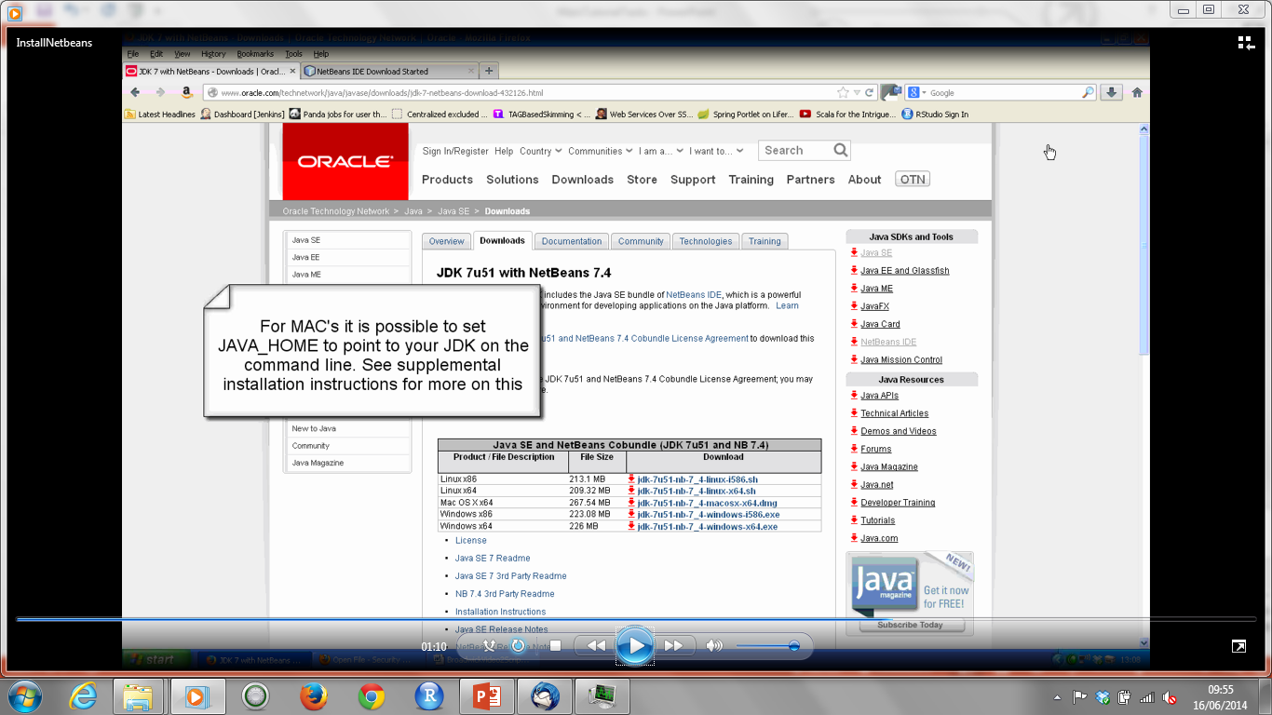

Slide 9
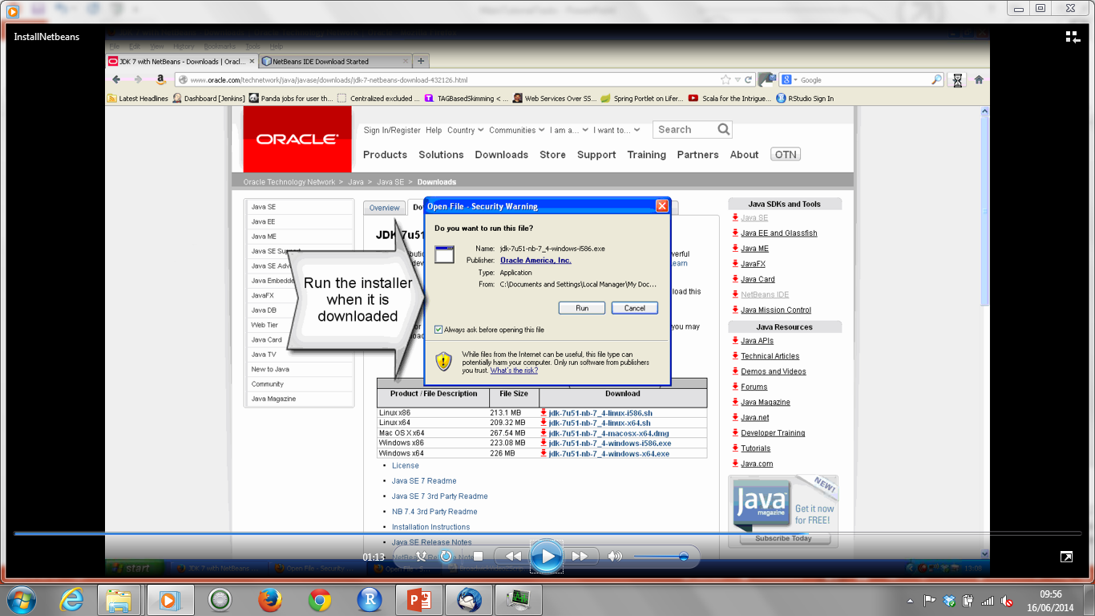

Slide 10


Slide 11
Building Broadwick in Netbeans
*** Internet connection also necessary at this point ***
Follow detailed instructions in supplementary notes to build Broadwick
Video also available to show how to fix problem with unit tests if encountered during build.

Slide 12
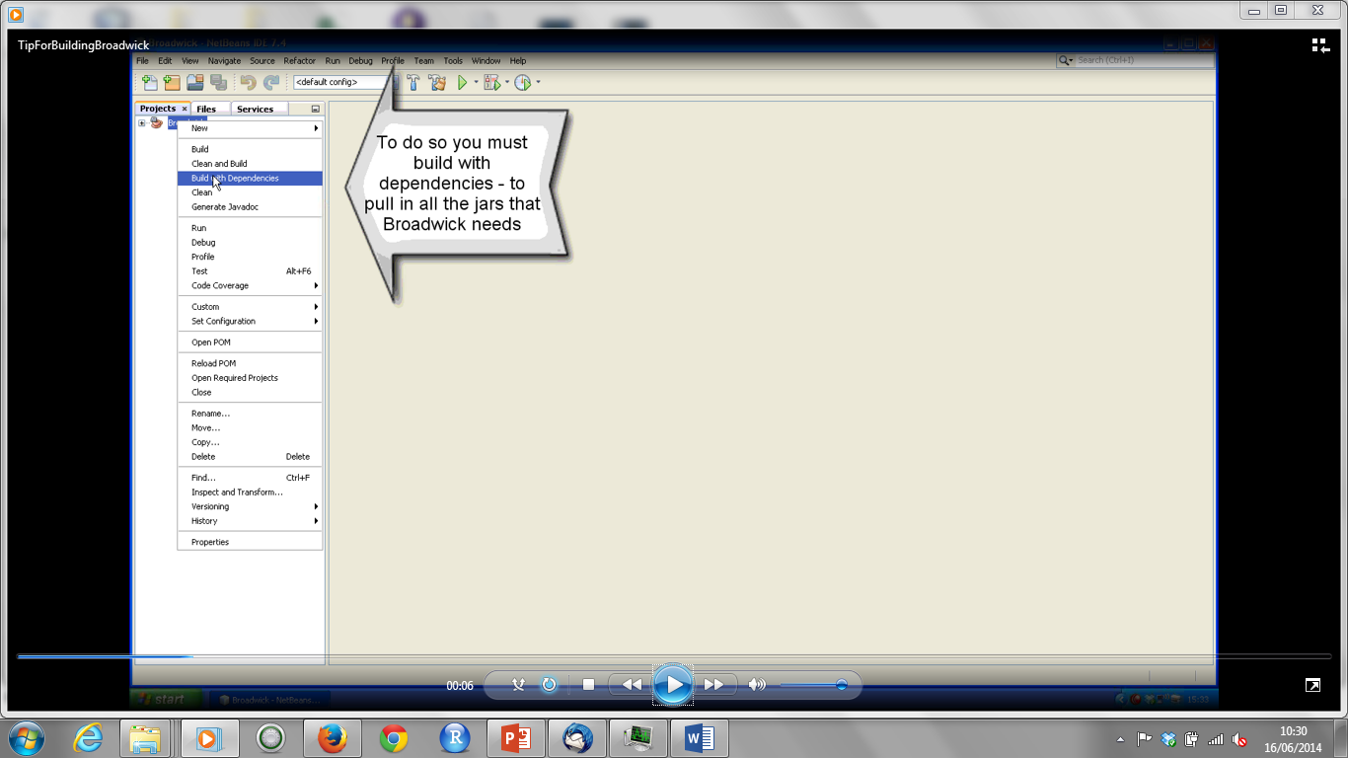

Slide 13
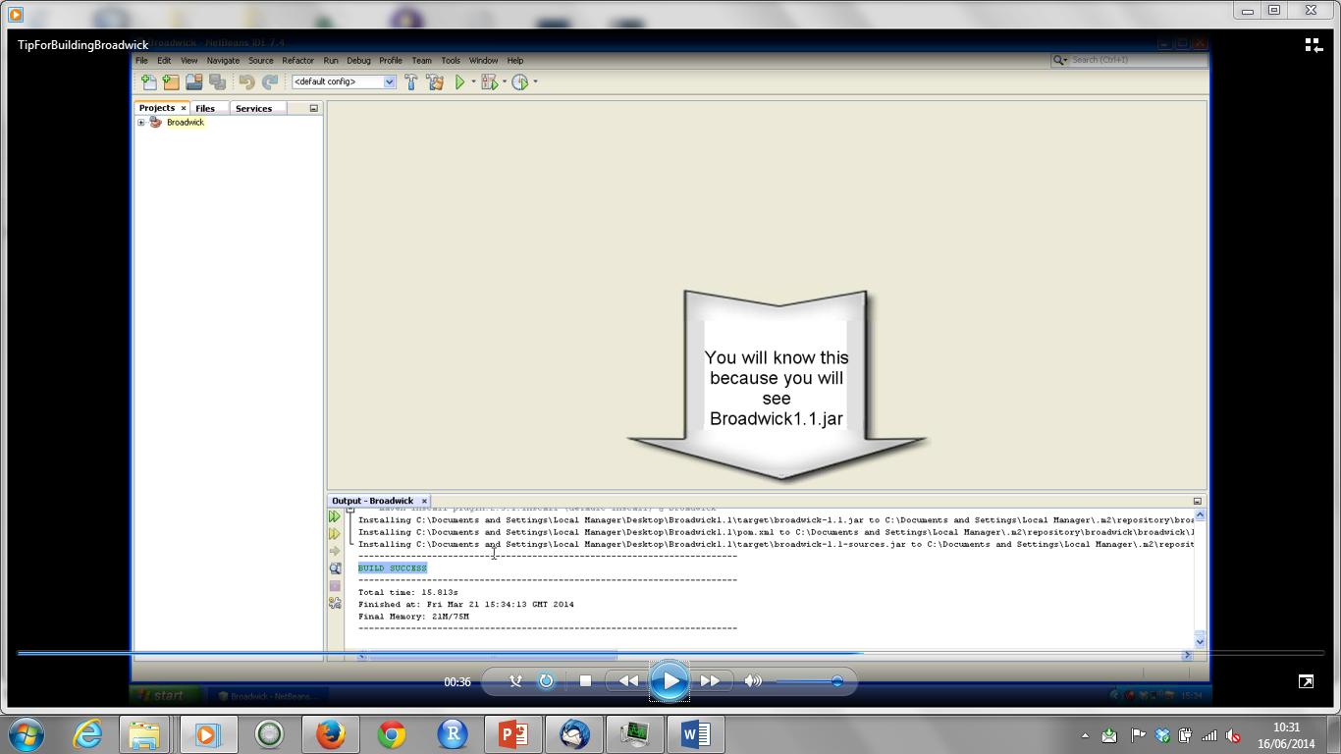

Slide 14
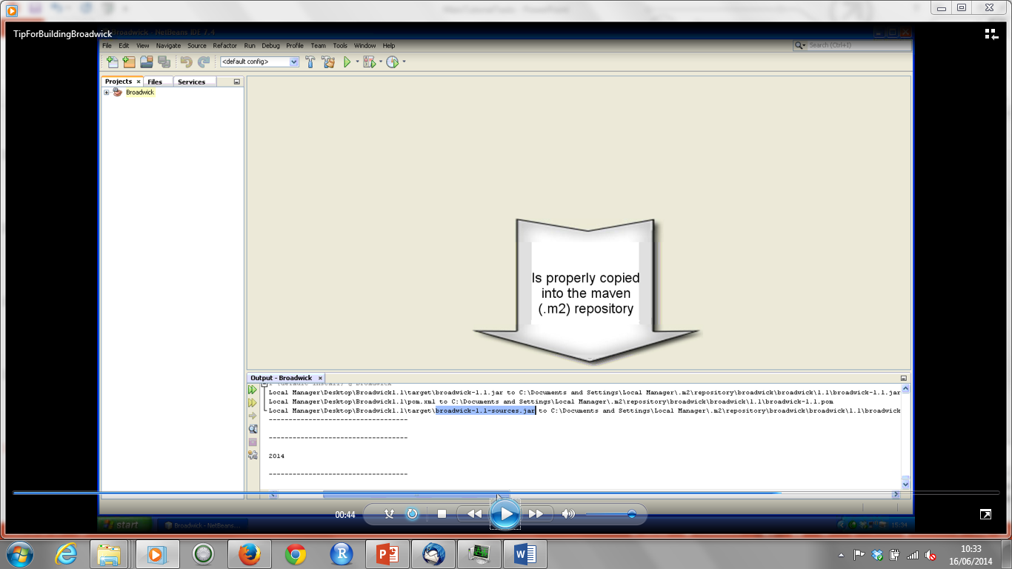

Slide 15
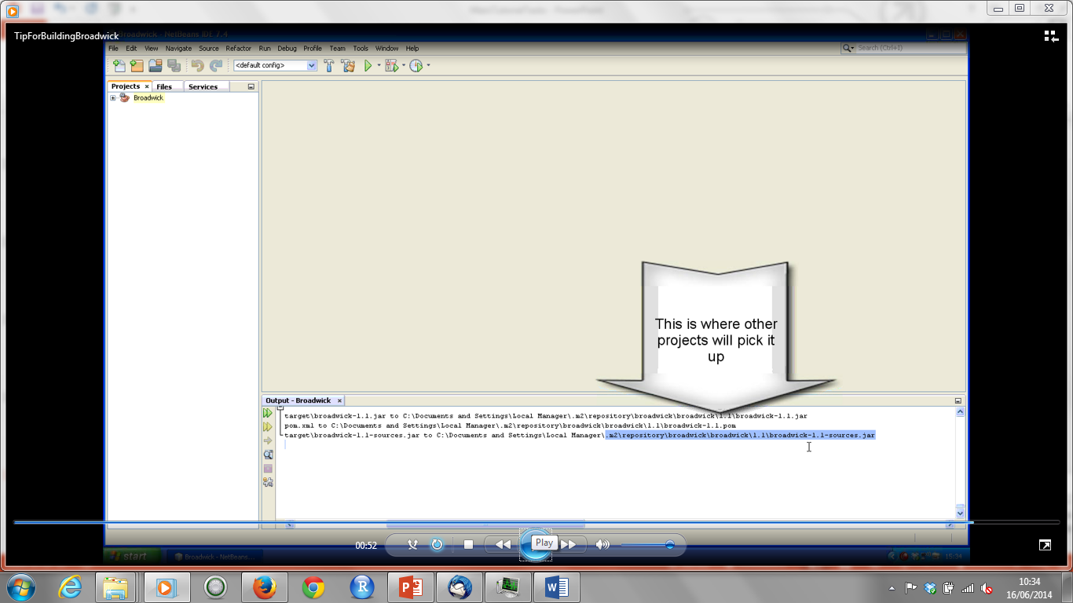

Slide 16
Running a simple model with Broadwick
Download StochasticSIRBasic code (or copy from usb stick) and unzip it
Open it in Netbeans (Go to `File` and `Open Project`) and open Model class
Note Broadwick as project dependency – see pom.xml file
Open unzipped StochasticSIRBasic project folder to view XML file
Make sure class name in xml is same as in project folder
Setting project to read XML
Right click project and choose `Properties` in menu
Go to `Run` and add Main class and Arguments
Run model by right clicking project and choosing ‘Run’ from menu
Open XMl config file and add new parameter
Add instance variables and Lombok packages
Use getParameterValue method to read from XML
Run model again to see value printed to screen

Slide 17
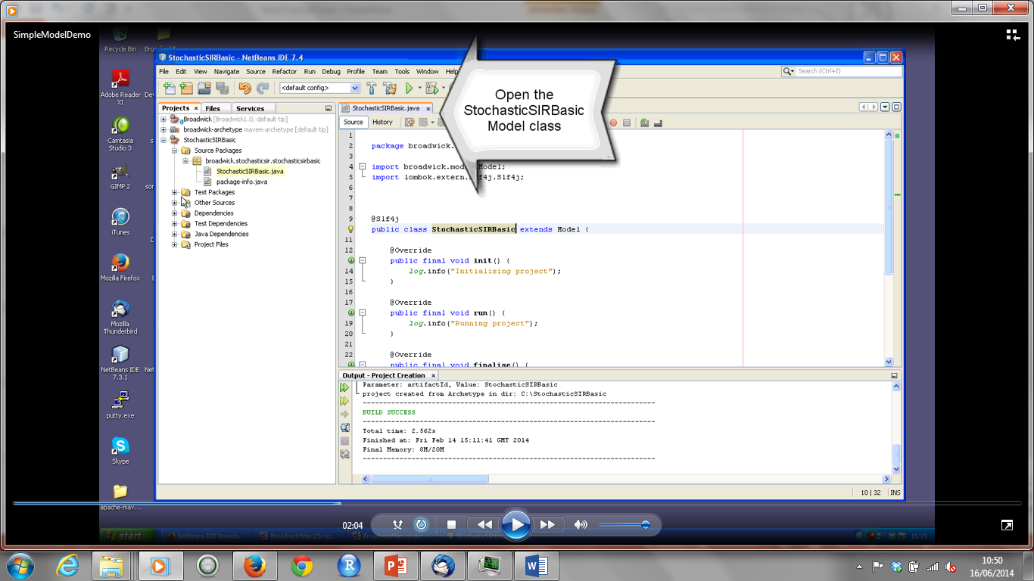

Slide 18
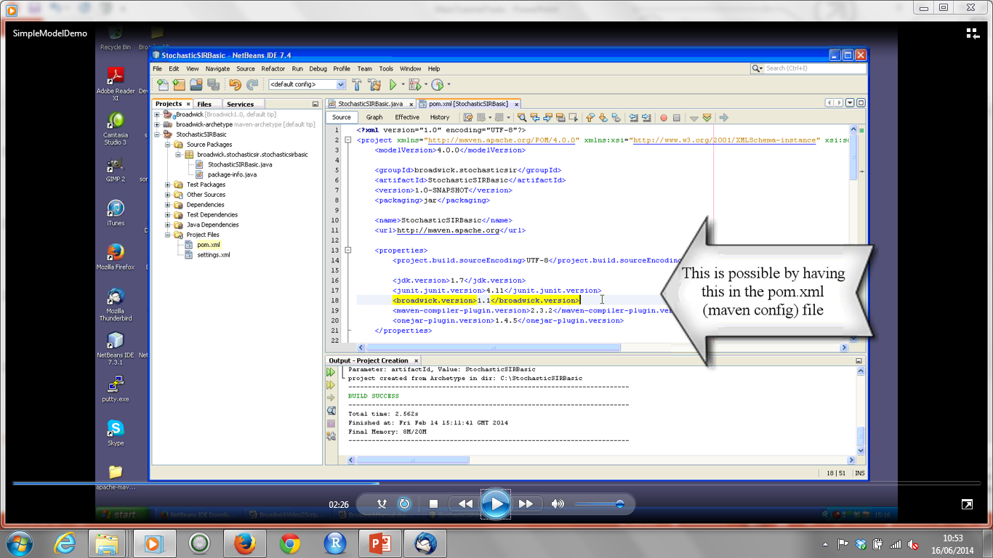

Slide 19
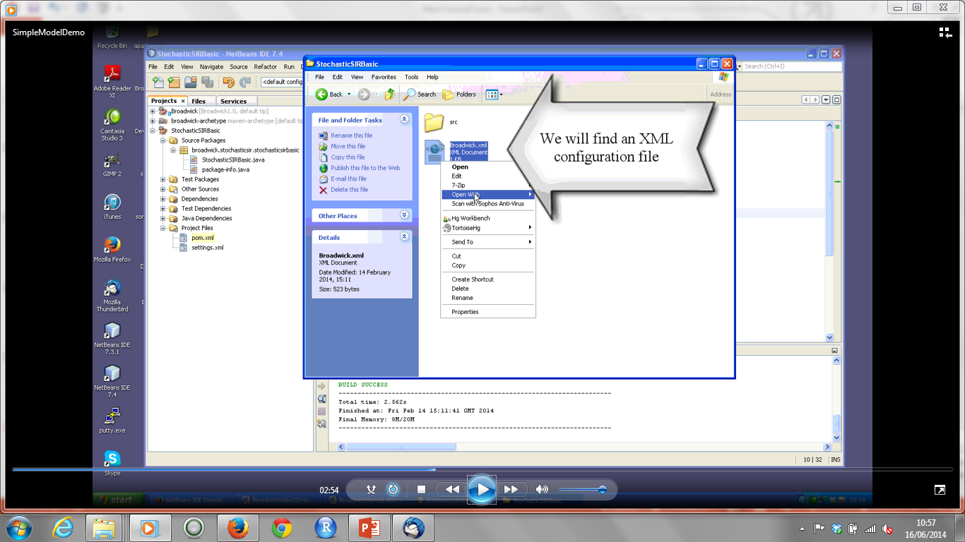

Slide 20
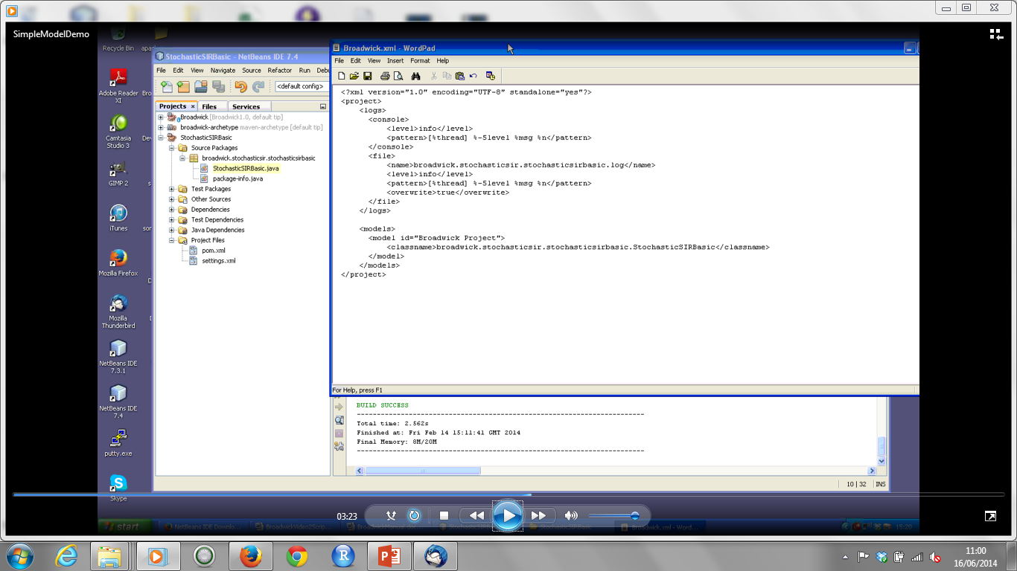

Slide 21
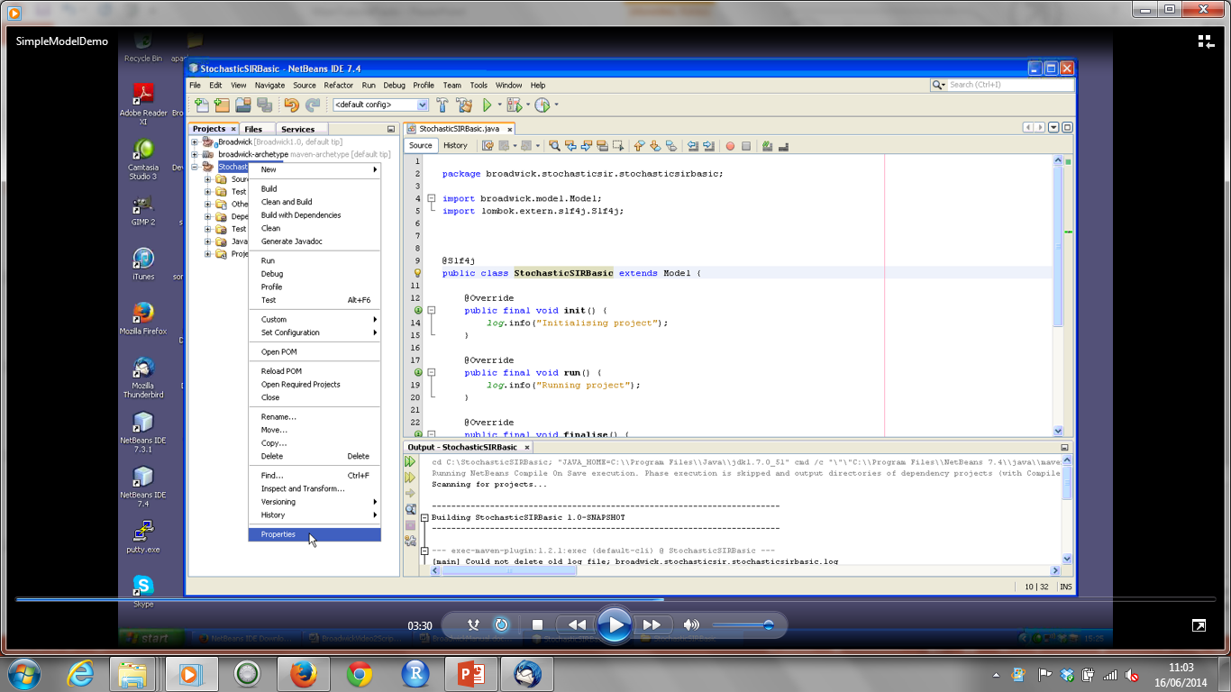

Slide 22
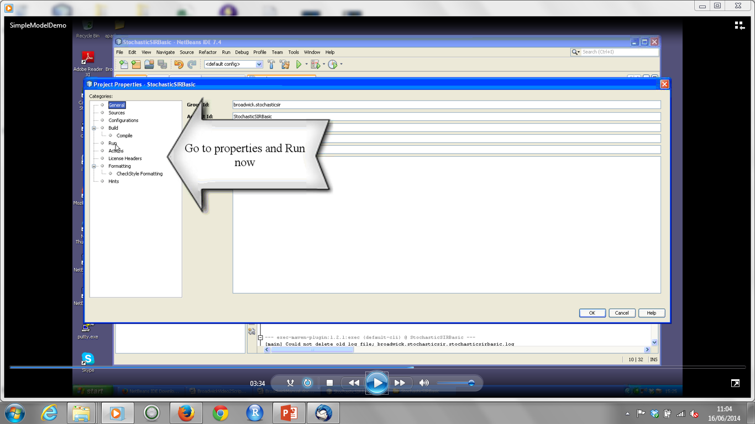

Slide 23
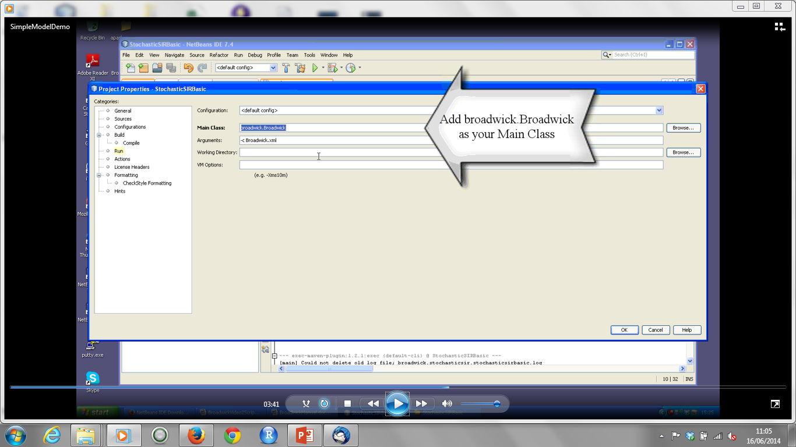

Slide 24
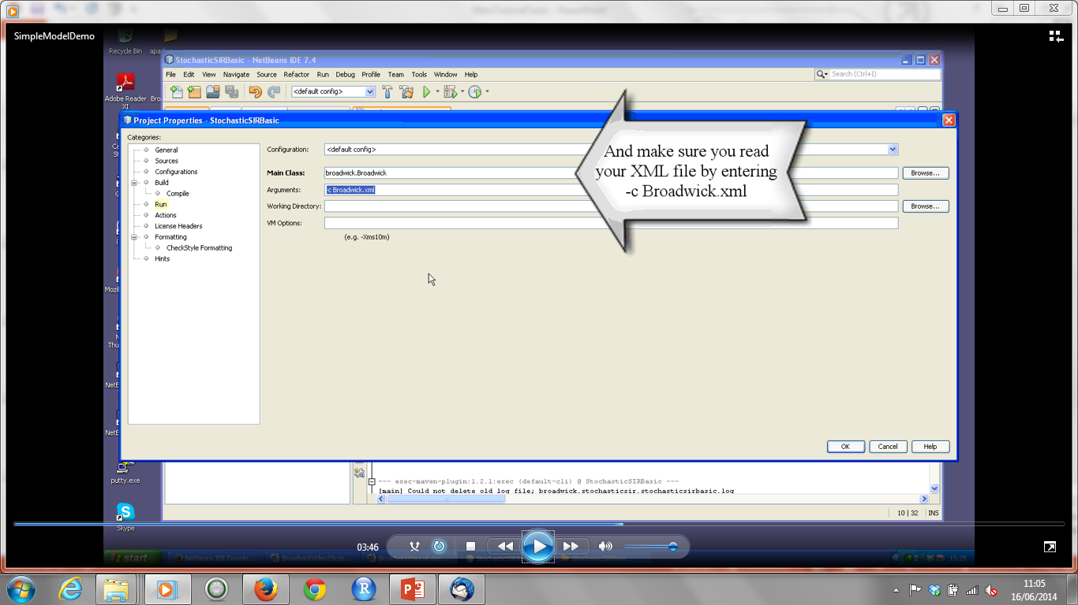

Slide 25
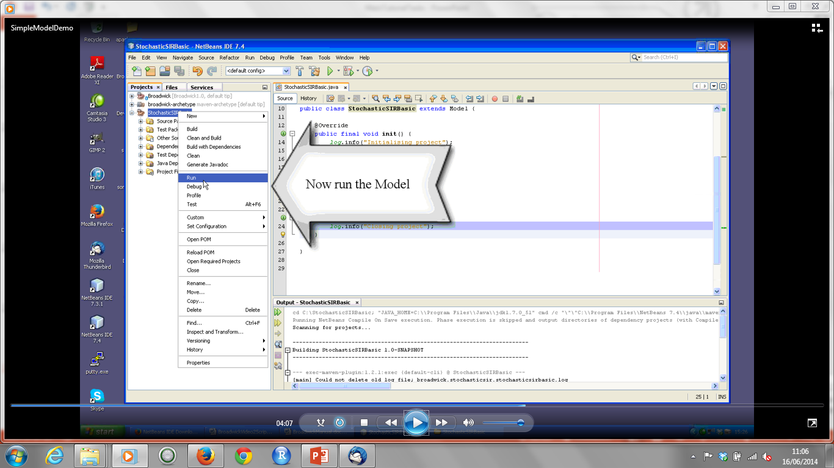

Slide 26
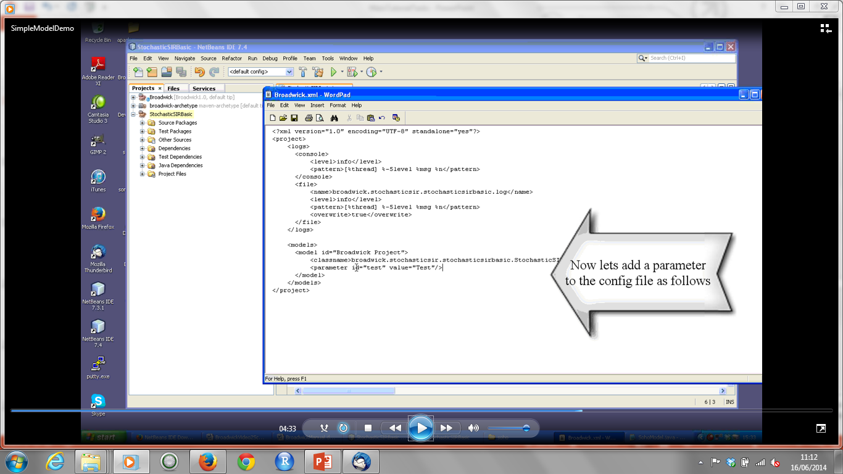

Slide 27
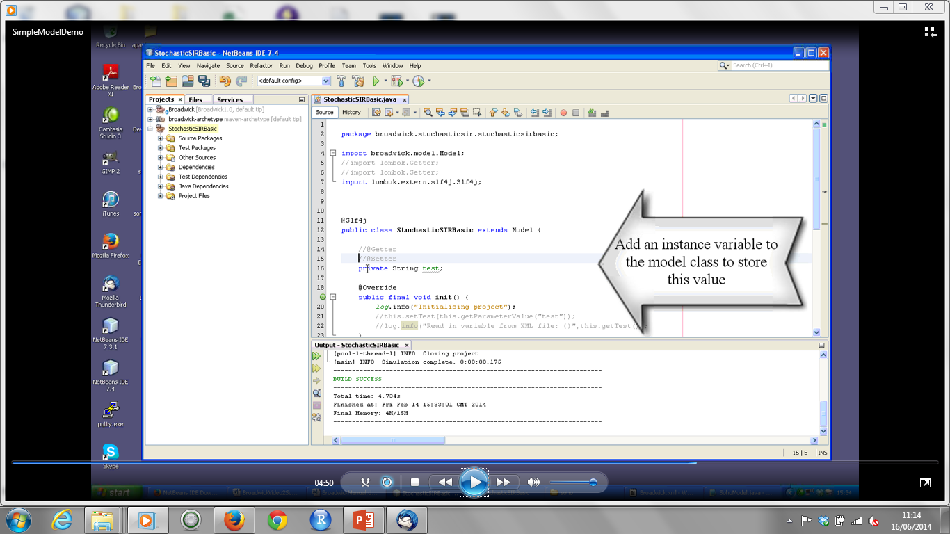

Slide 28
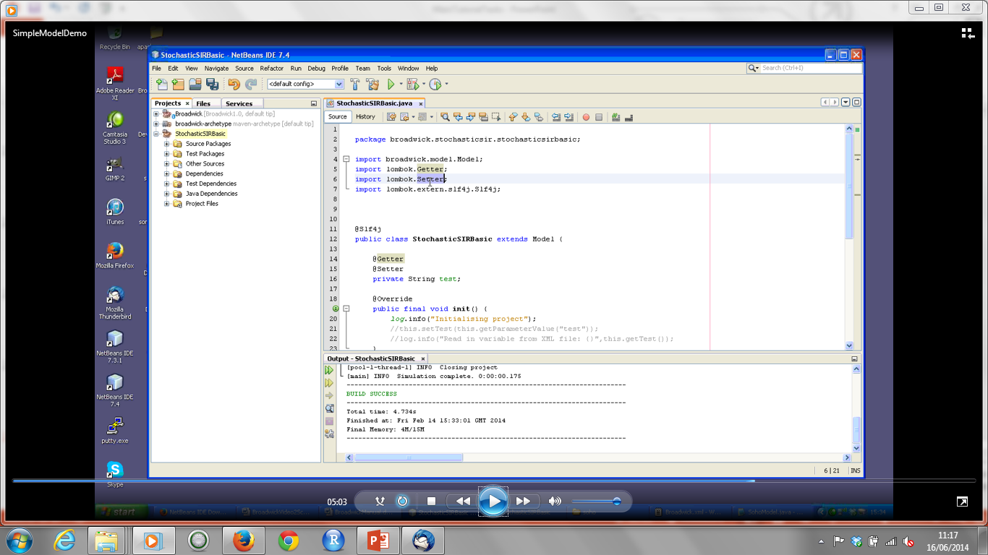

Slide 29
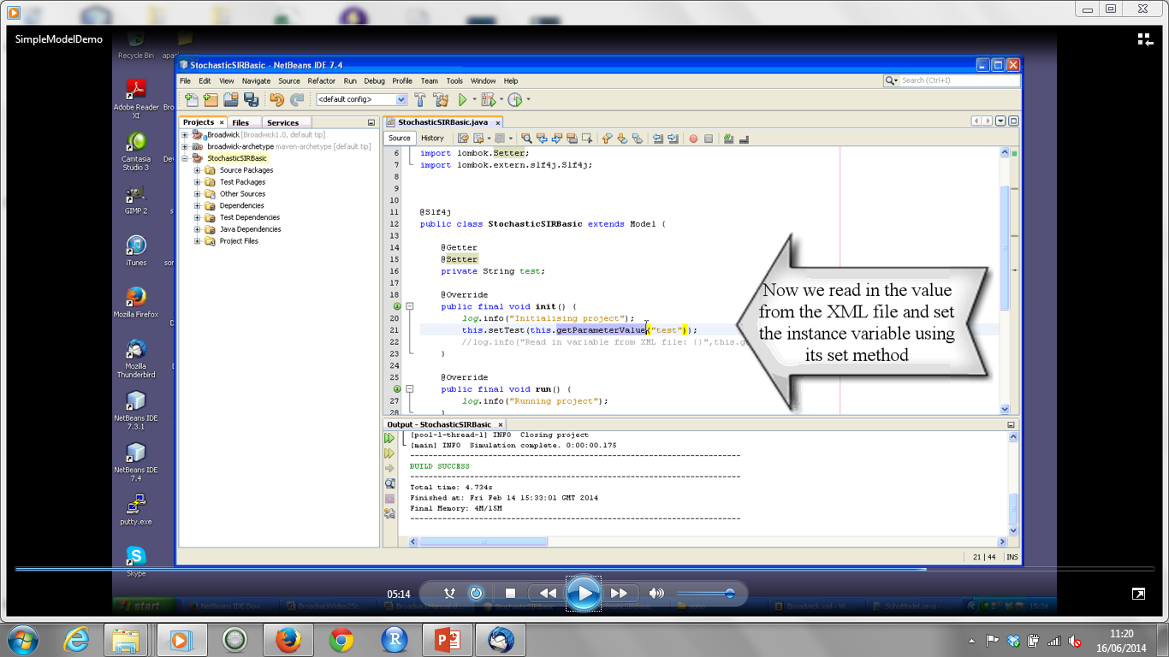

Slide 30
Creating a Stochastic SIR Model – Part 1
Download StochasticSIR code (or copy from usb stick).
Familiarising ourselves with classes in implementation
Open UML diagram provided.
Open model class and pom.xml class to view
Uncomment 1a in model class to view instance variables
Uncomment 1b to see how variables read in from XML config file
Open XML file to see configuration variables and their values.
Instantiating Stochastic classes (view UML diagram again)
Uncomment code 2a and 2b

Slide 31
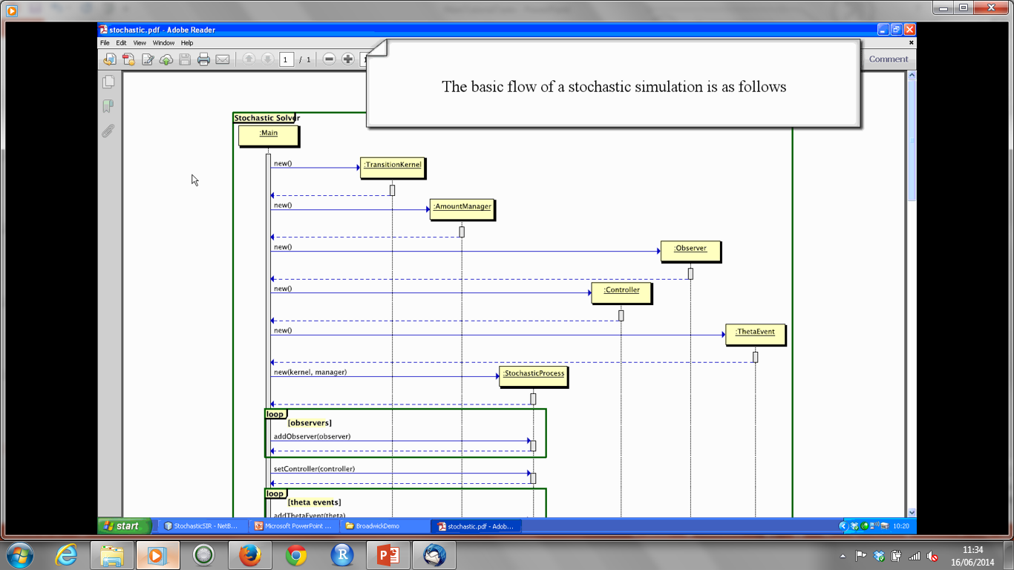

Slide 32
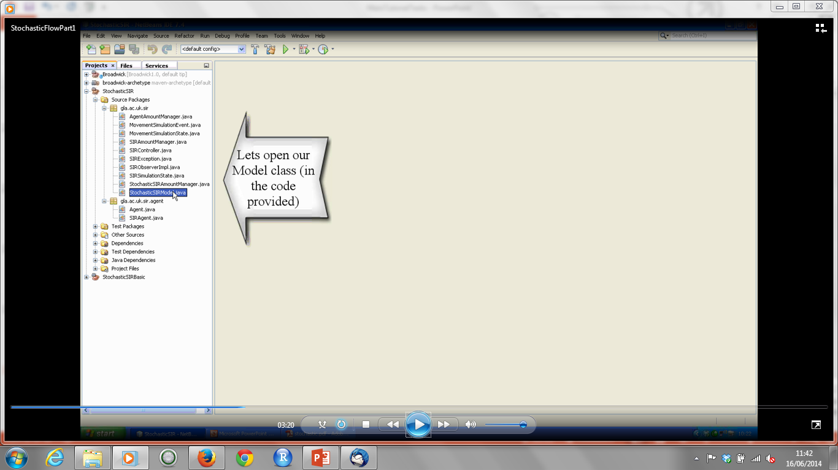

Slide 33
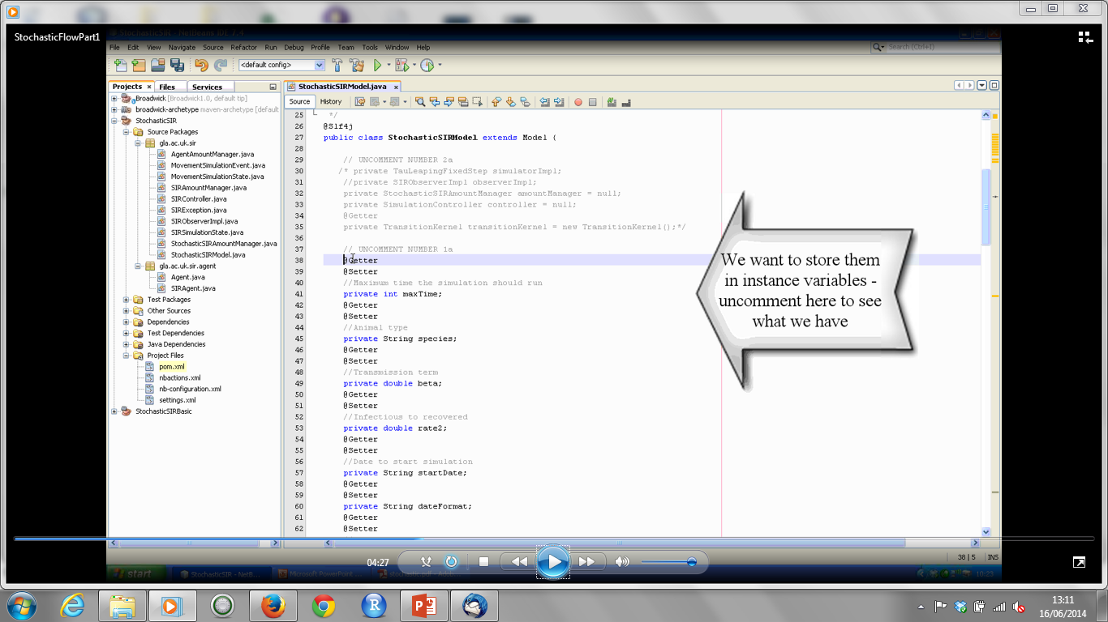

Slide 34
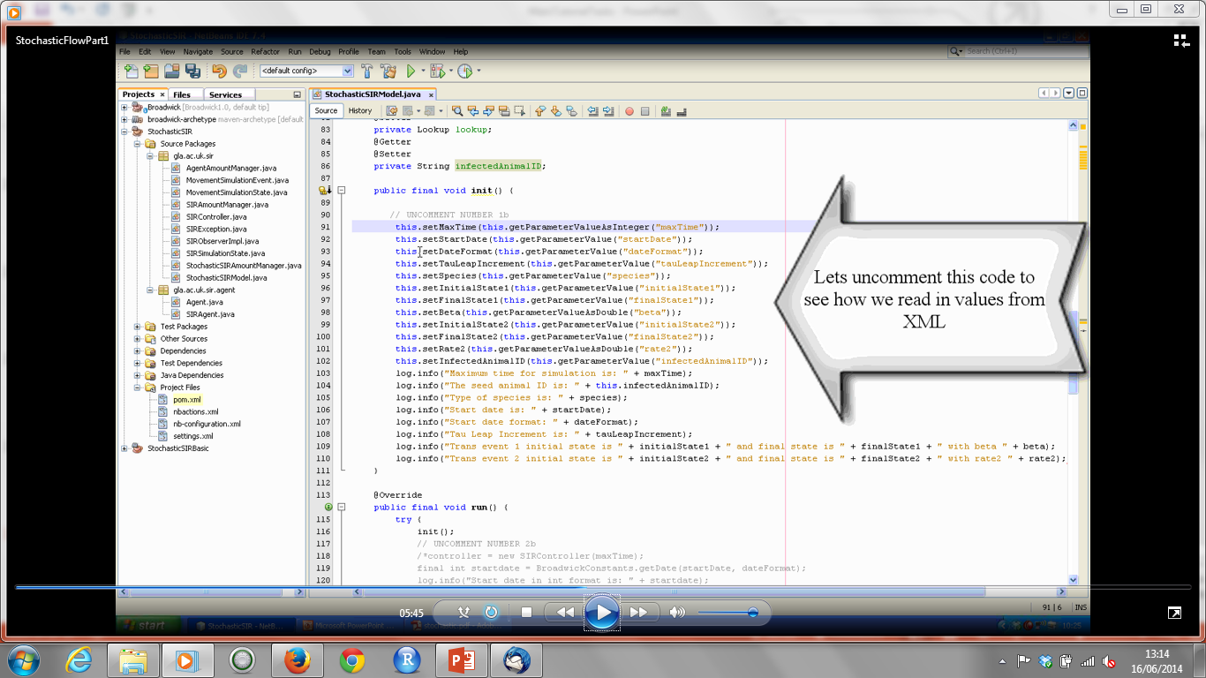

Slide 35
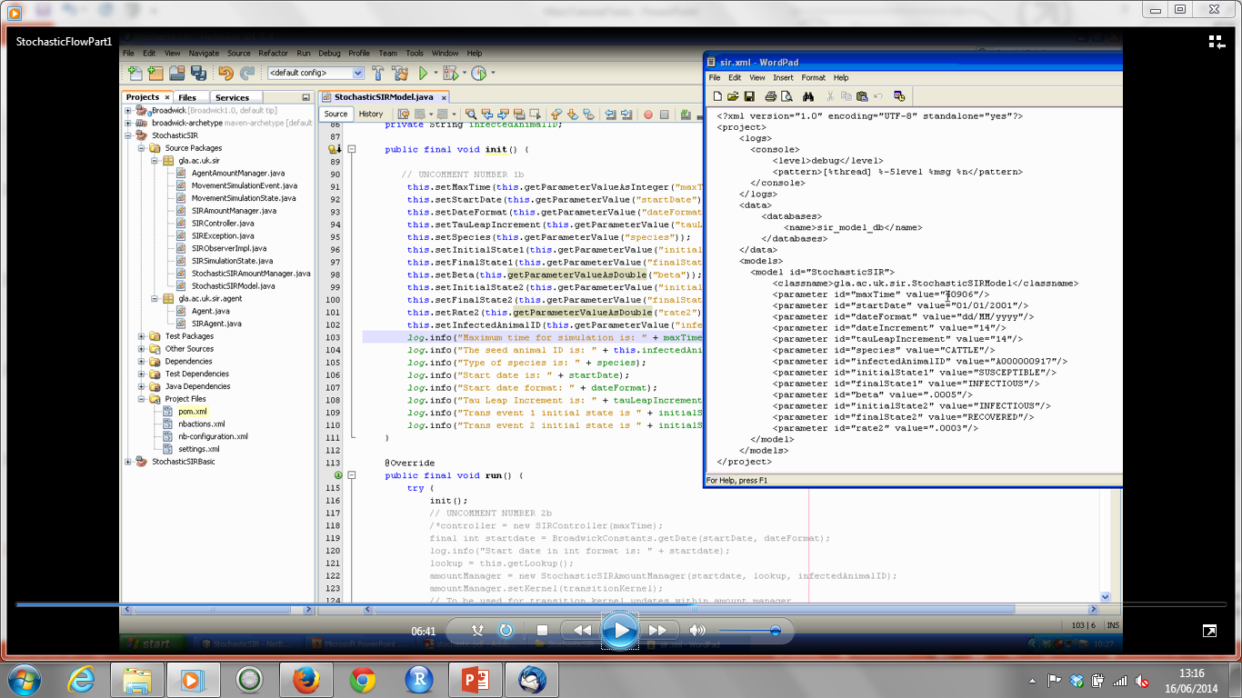

Slide 36
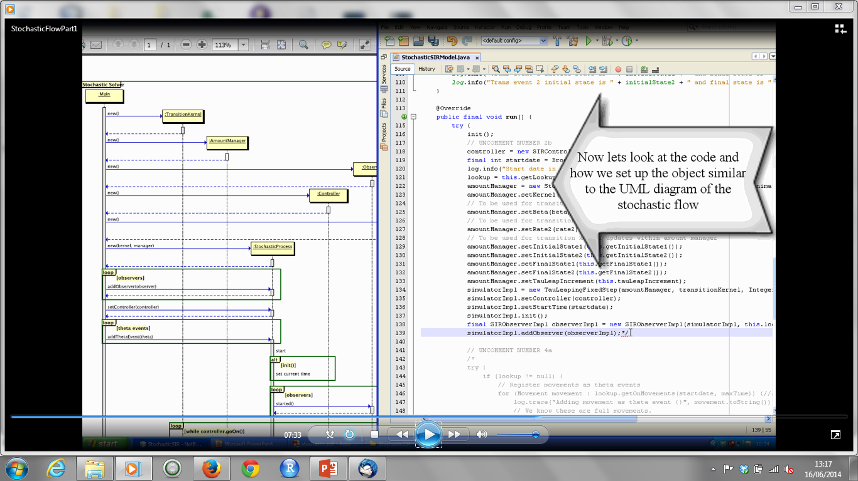

Slide 37
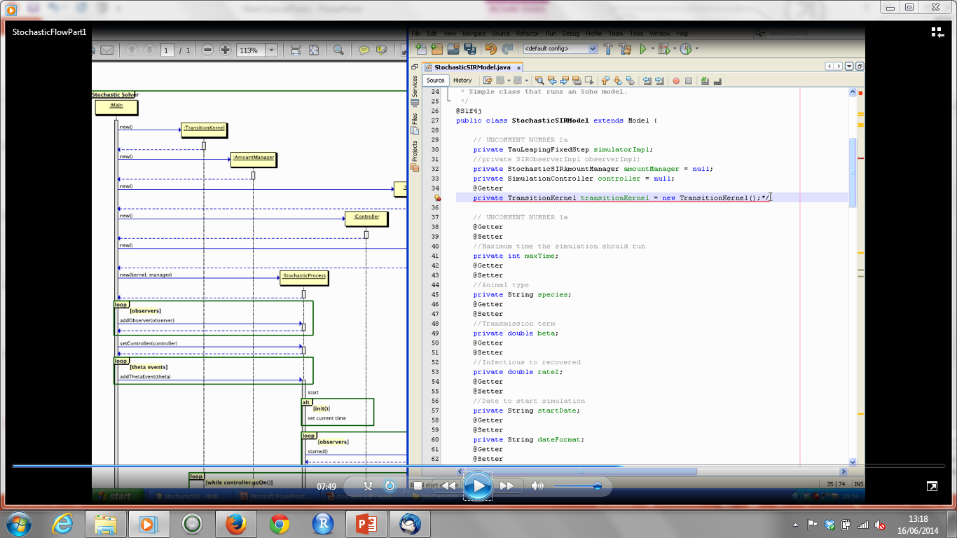

Slide 38
Creating a Stochastic SIR Model – Part II
Open StochasticSIRAmountManager class
View instance variables, object containers….
Open SIRAgent class
View attributes stored for each individual animal.
Back to AmountManager
Uncomment two methods that update Transition Kernel
Introduce SIRSimulationState and SIRSimulationEvent classes
When to update transition kernel – view UML diagram
Handling input data
Open up XML file called sir.xml.withfiles
When viewing XML file for movements – compare to simMov_movementRecords.csv
When viewing XML file for animal history – see simMove_lifeHistories.csv
When viewing XML file for location data – see simMove_farmLocations.csv
Open LookUp class to show getOnMovement method
Return to model class – uncomment 4a, Open Movement class to view contents
Introduce movement state and event classes
Back to AmountManager – uncomment createInitialAnimalCollection method.

Slide 39
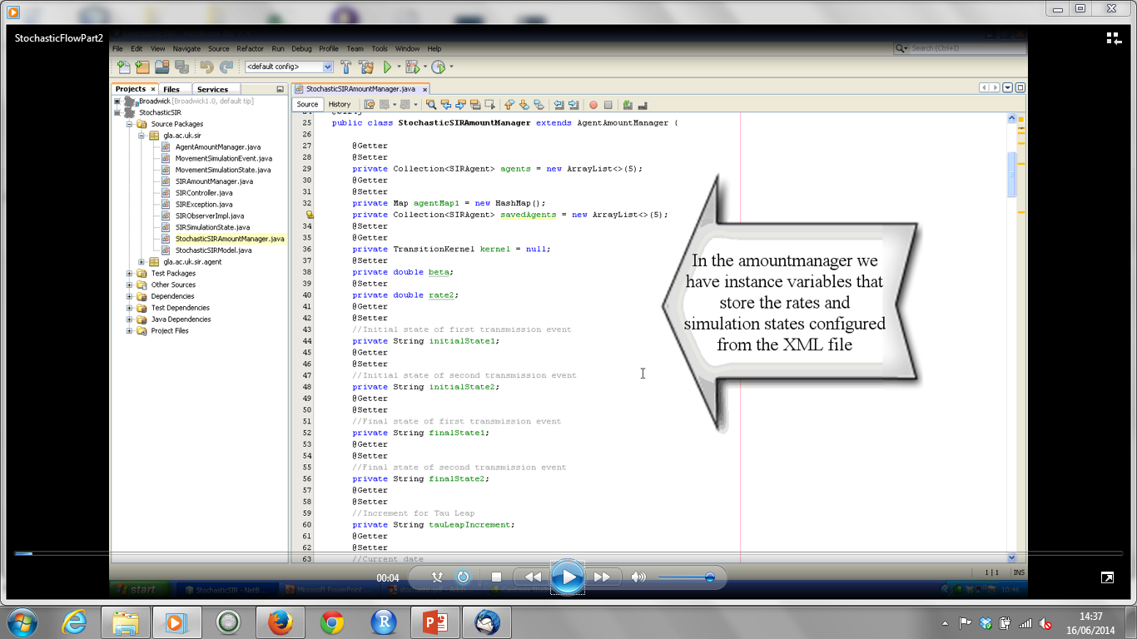

Slide 40
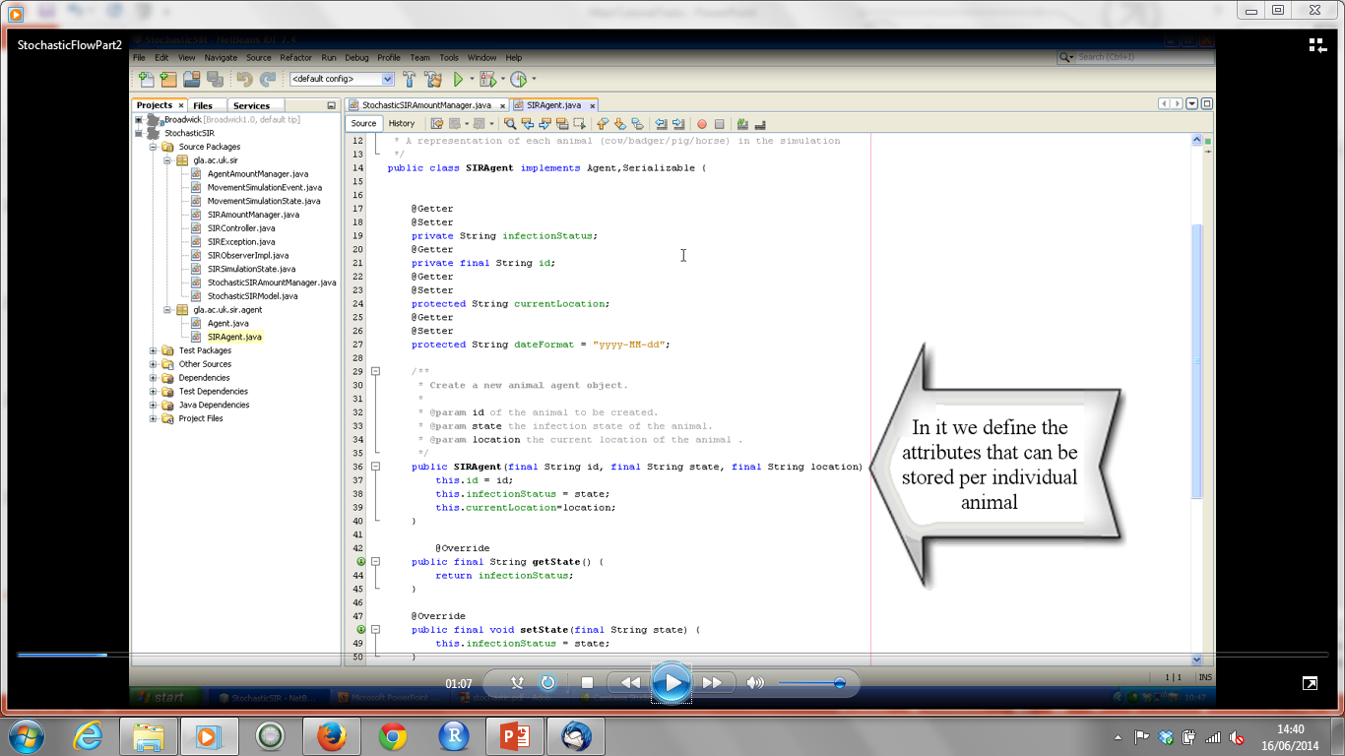

Slide 41
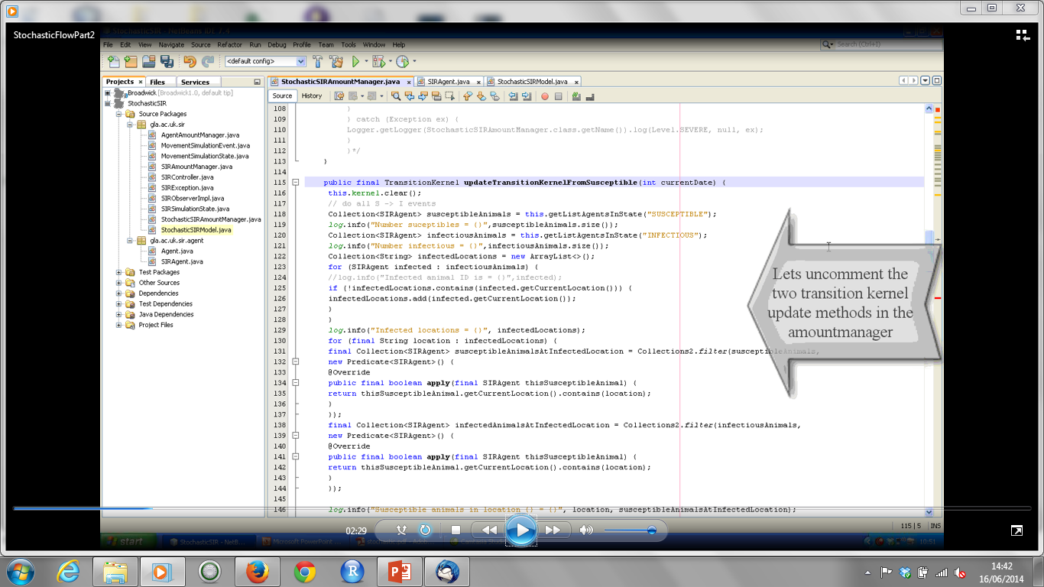

Slide 42
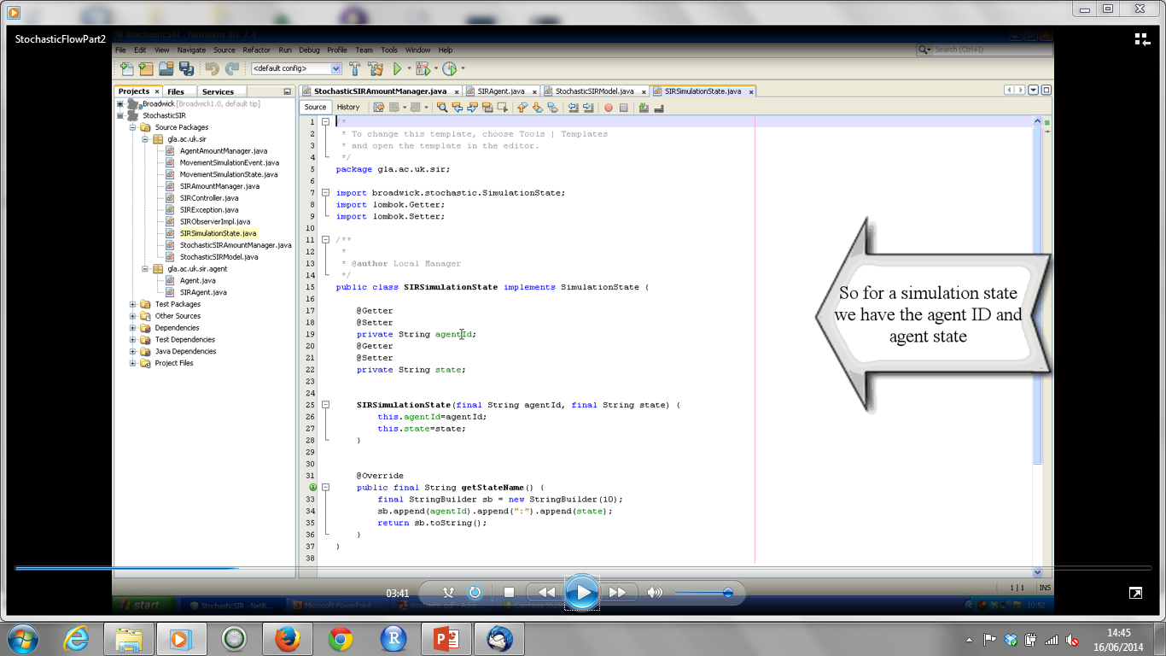

Slide 43
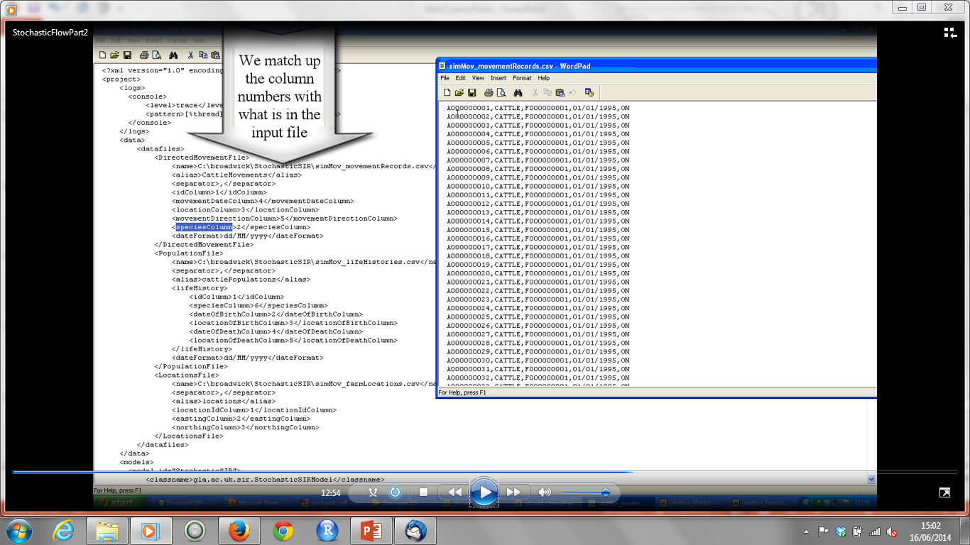

Slide 44
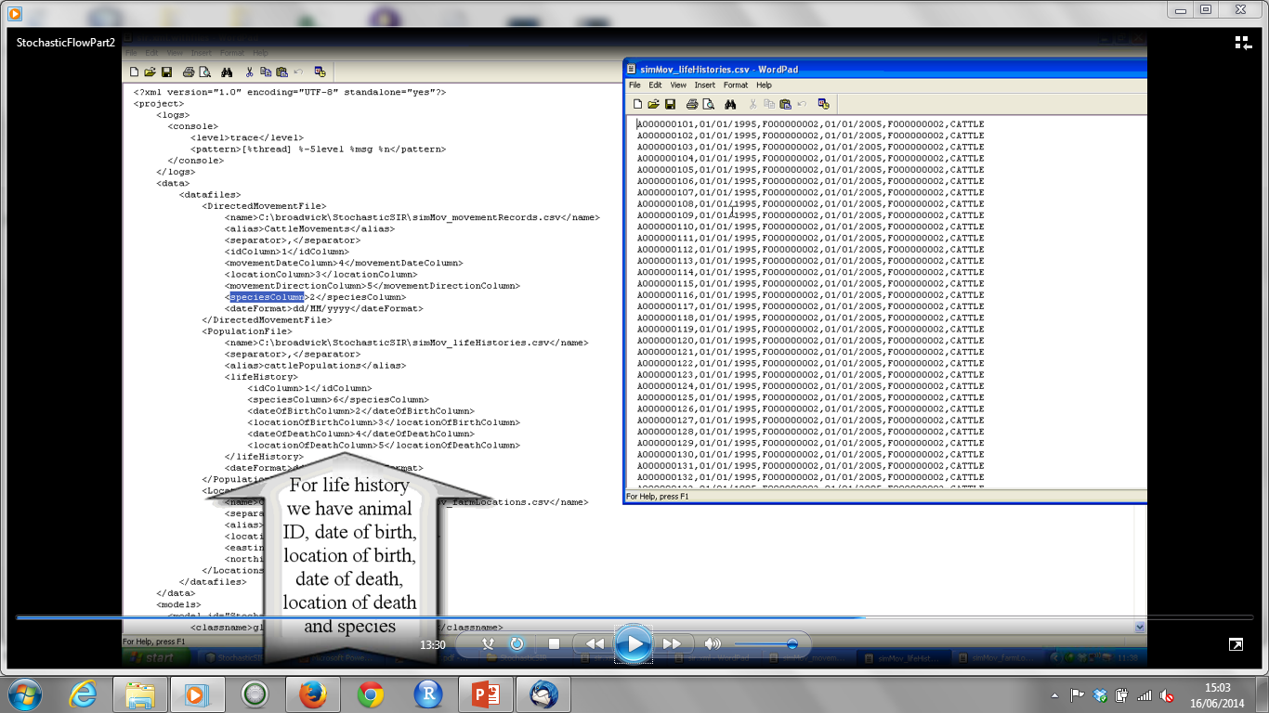

Slide 45
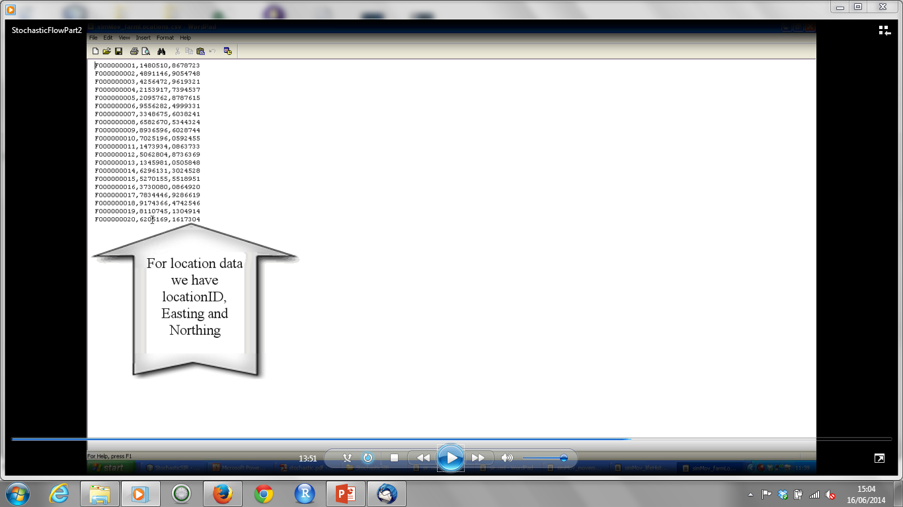

Slide 46
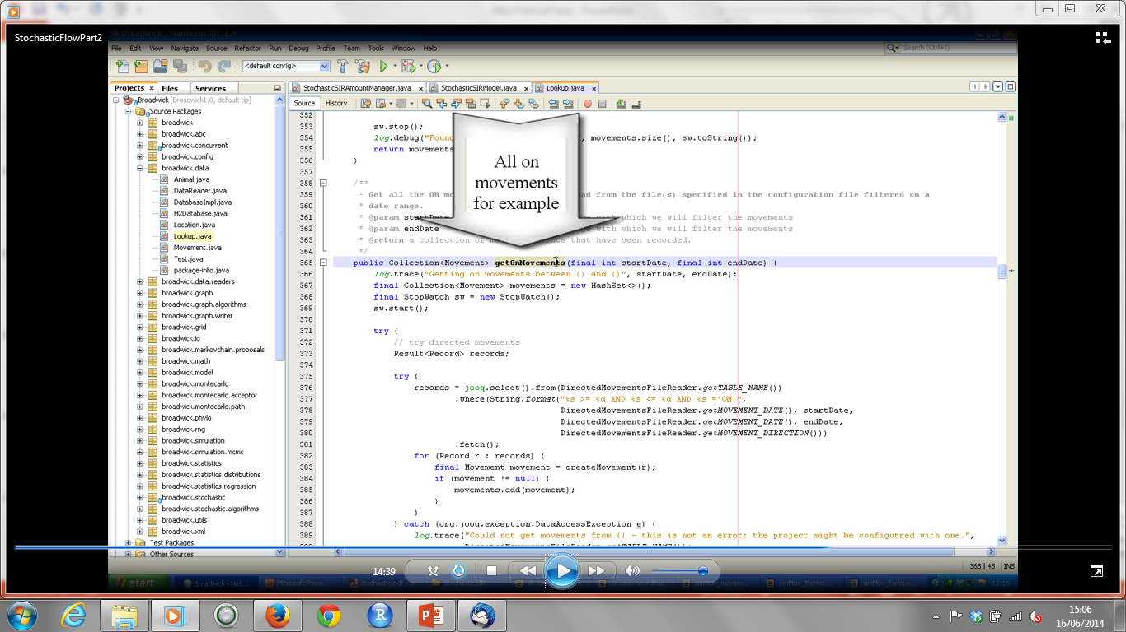

Slide 47
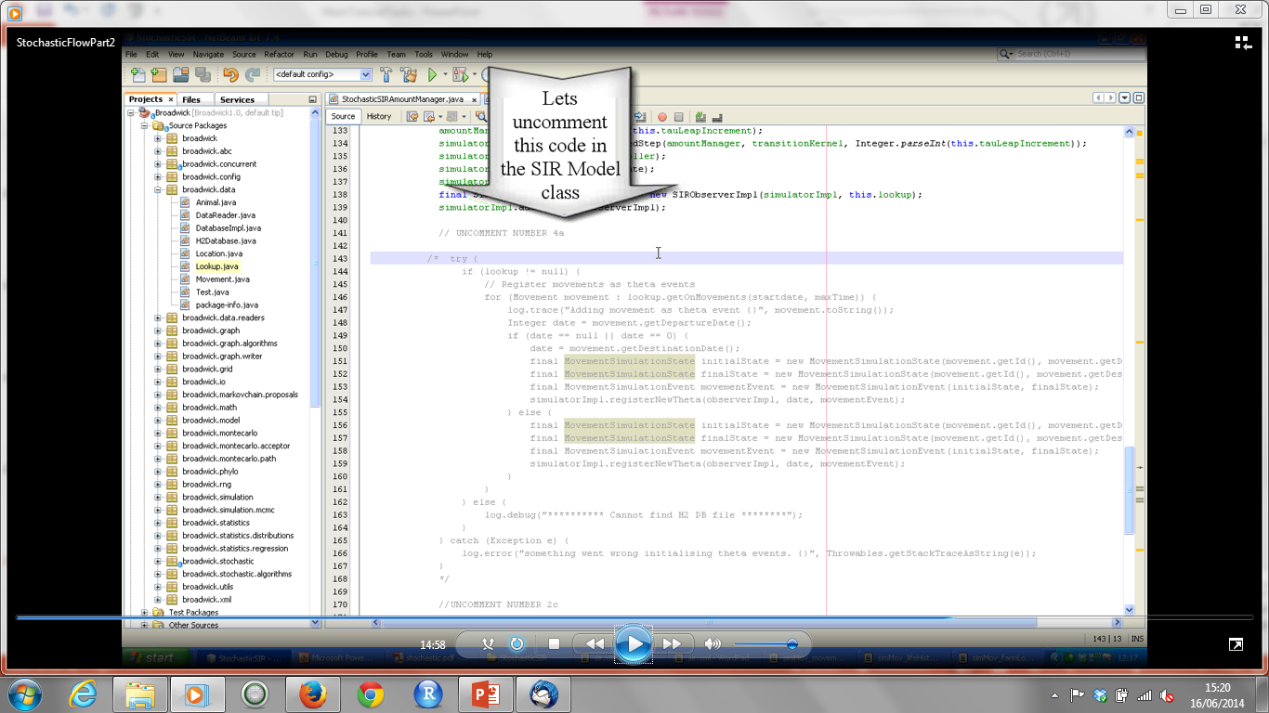

Slide 48
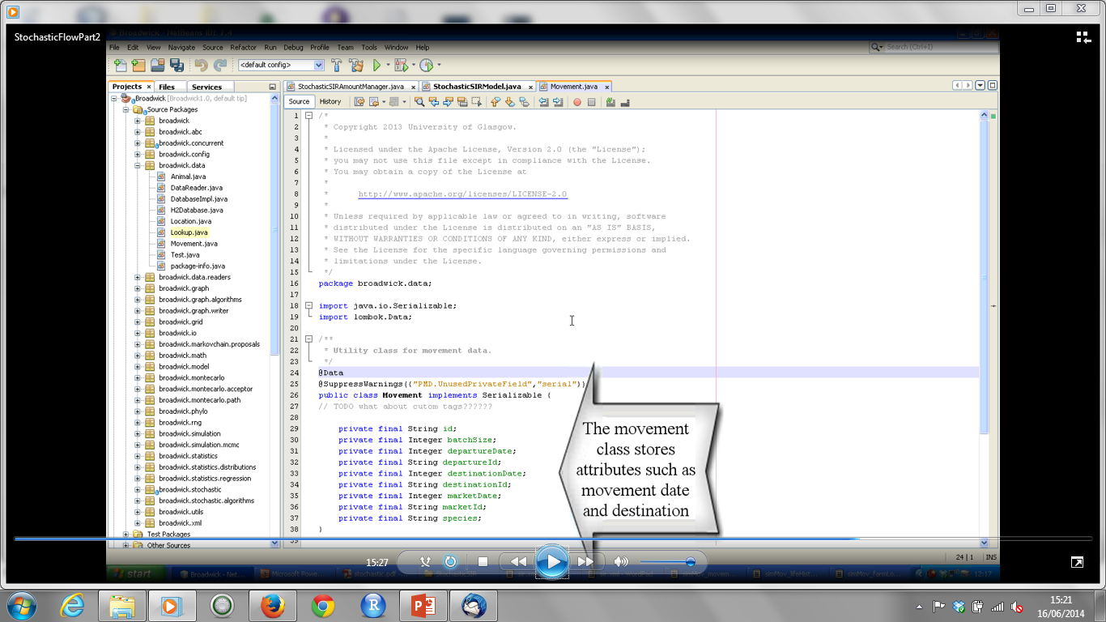

Slide 49
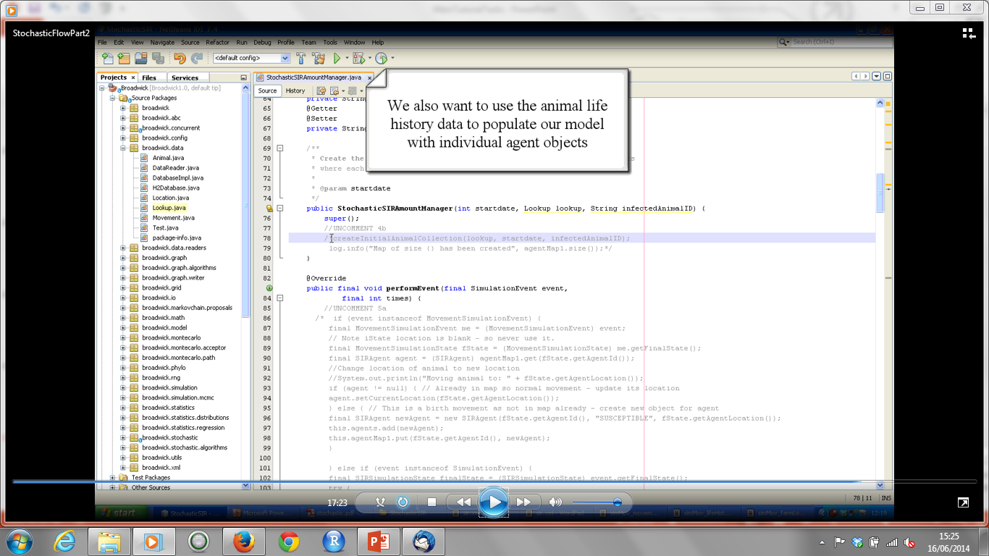

Slide 50
Creating a Stochastic SIR Model – Part III
Open StochasticSIRAmountManager class – uncomment 5a
Open SIRObserverImpl – view getAnimalsThatHaveDied method

Slide 51
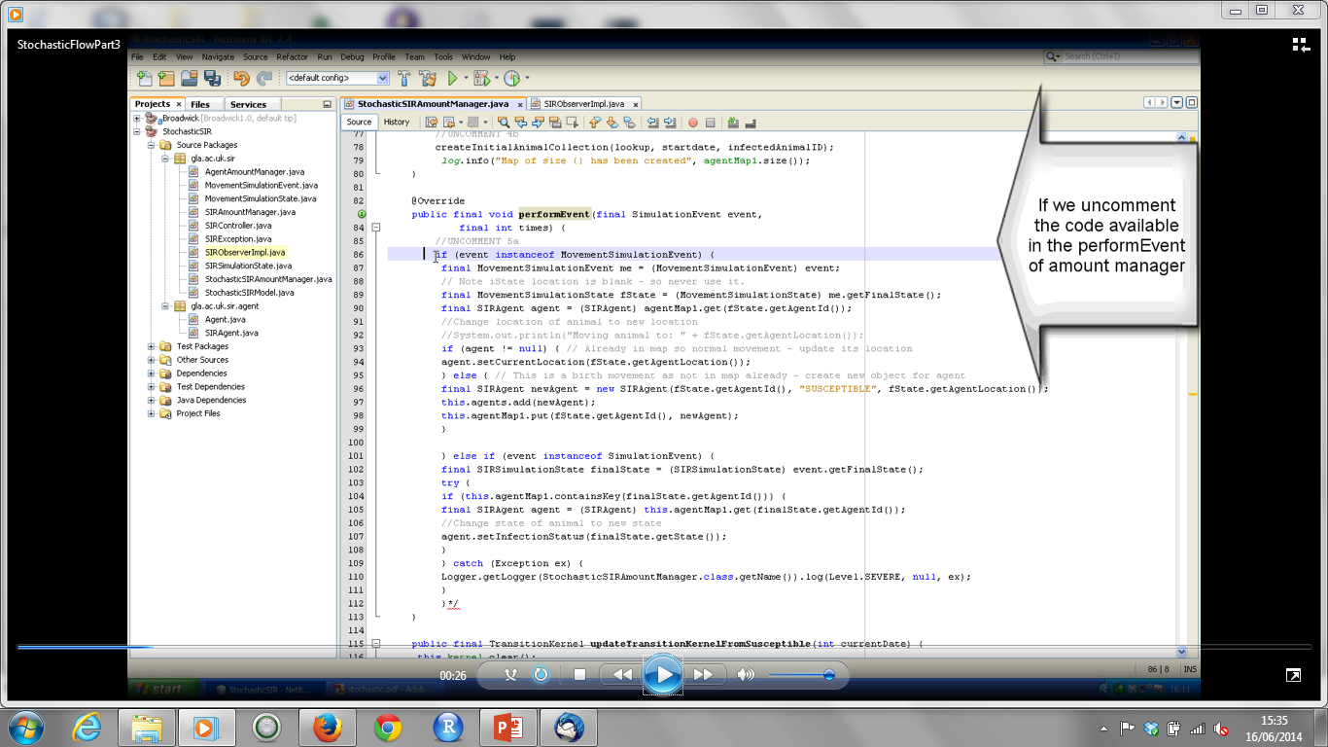

Slide 52
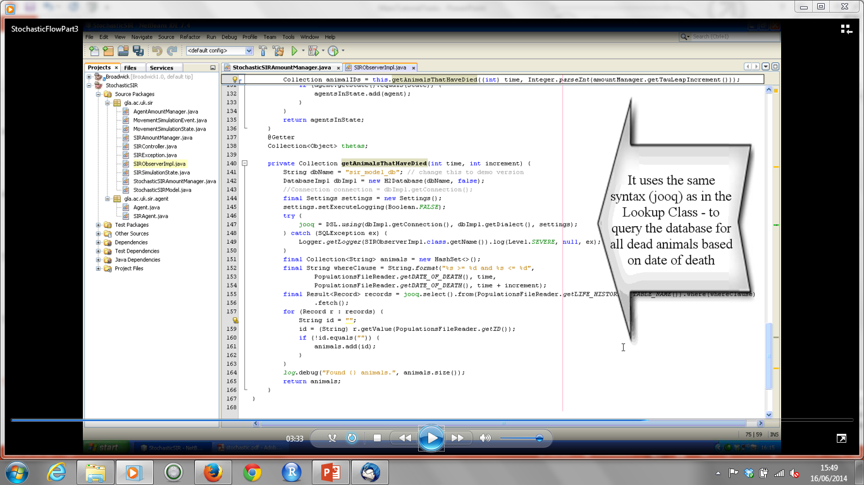

Slide 53
Creating a Stochastic SIR Model – Part IV
If not done already – build Broadwick (see supplementary instructions)
Then build StochasticSIR project with dependencies (so that it pulls in recently created Broadwick jar).
View Step method in SohoObserverImpl to see where step details are saved to file – this method is defined in AmountManager – open it.
Run project – right click and choose `Run` in menu.
View output file in project directory
Open R script also available in project directory copy it and paste in R
View plots of Susceptible, Infectious, Recovered for sample data

Slide 54
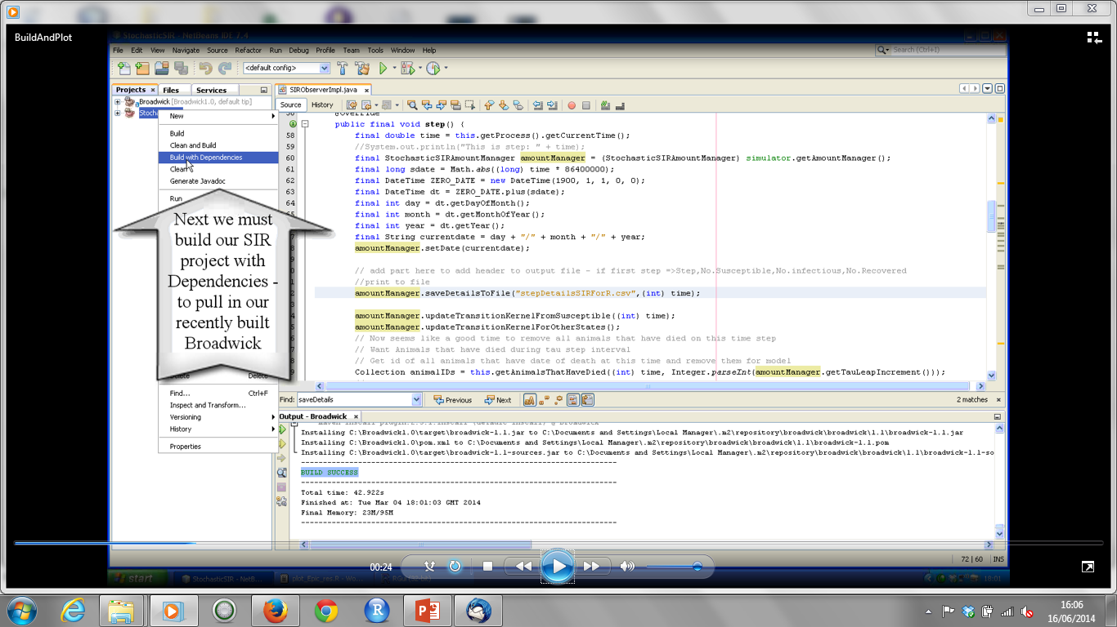

Slide 55
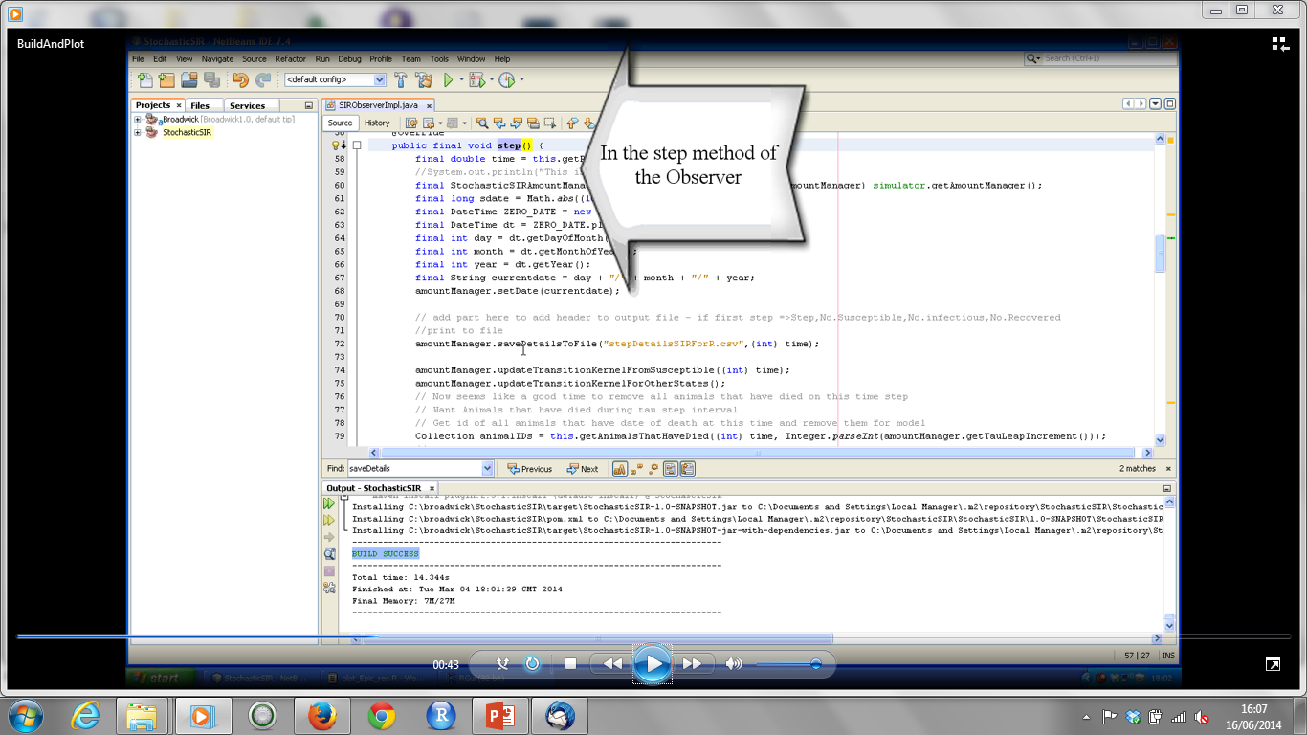

Slide 56
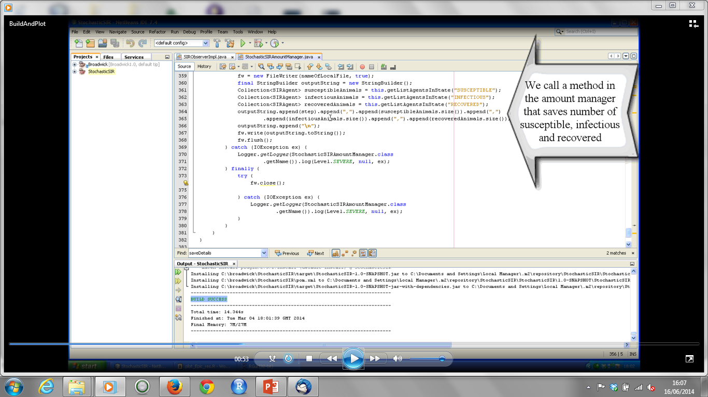

Slide 57
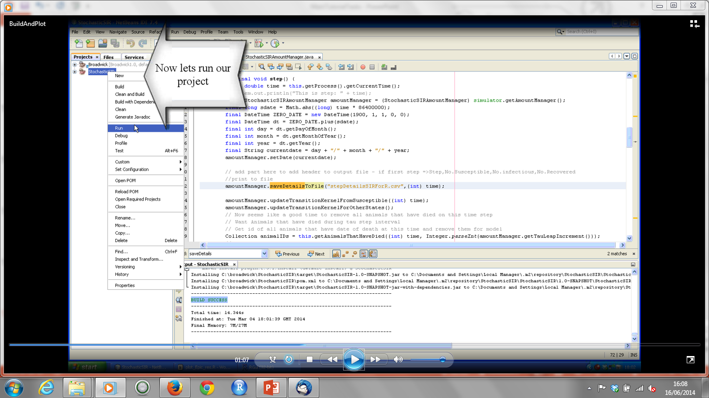

Slide 58
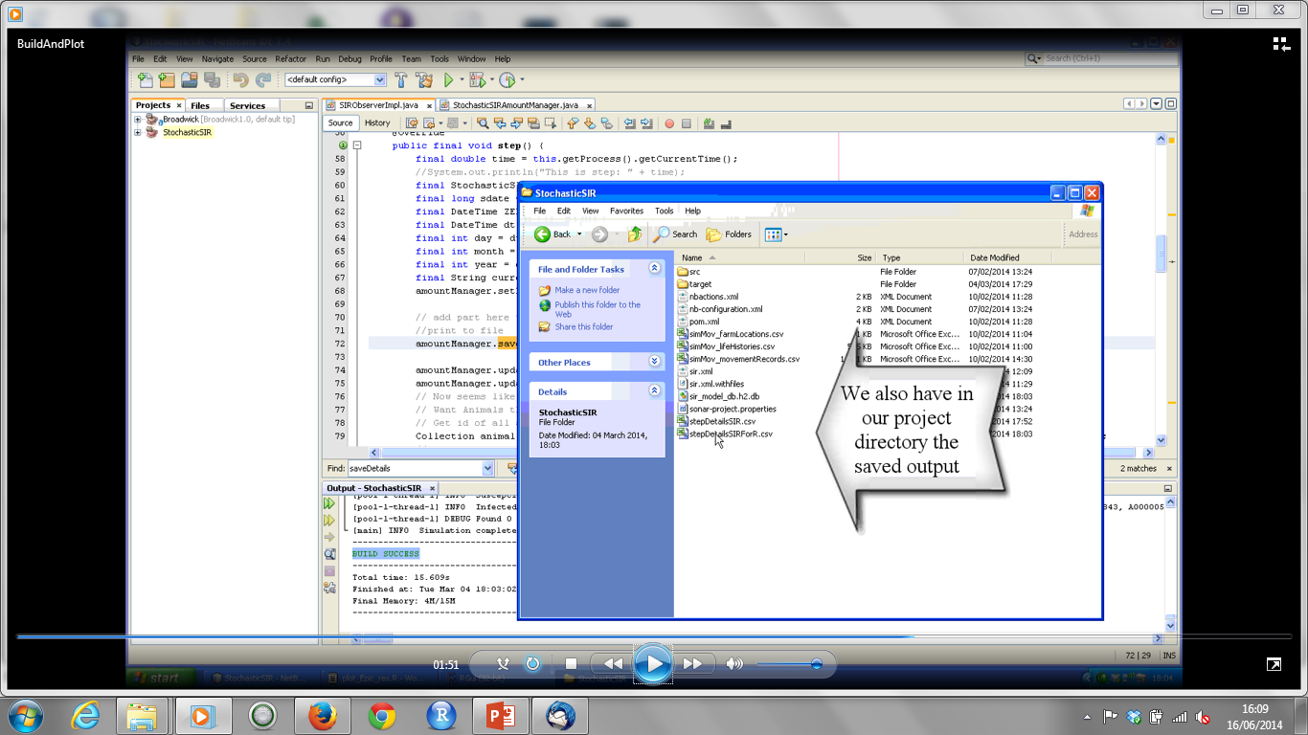

Slide 59
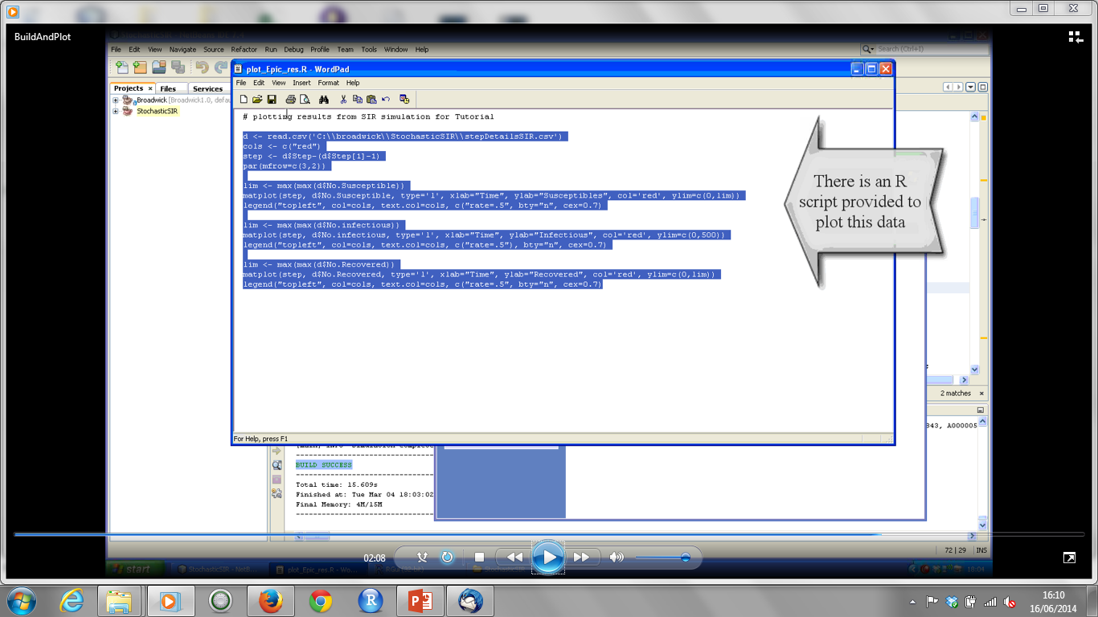

Slide 60
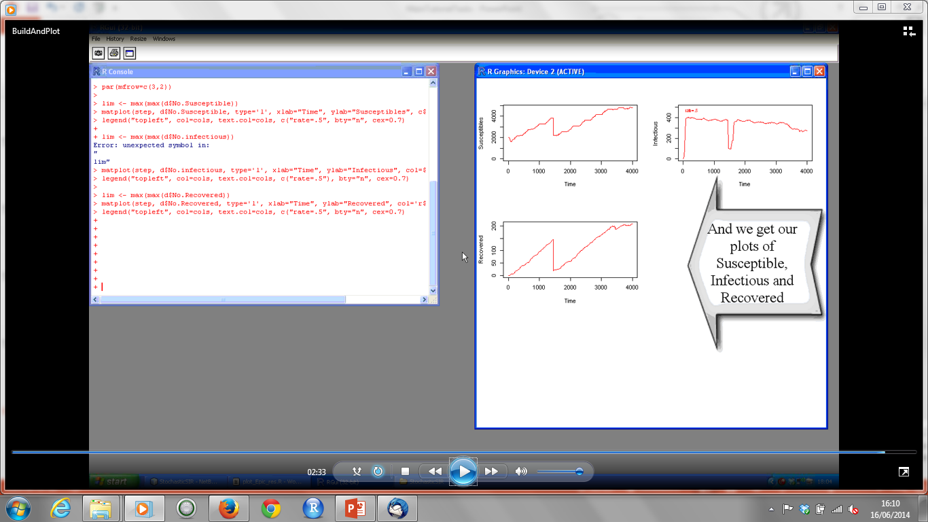

Slide 61
Multi-Threading in Broadwick
Download StochasticSIRAdvanced_ABC code (or copy from usb stick) and unzip and open in Netbeans
Open StochasticSIRModel class and view runScenarios method
Open SIRScenario class – see that Stochastic classes are instantiated here as before, AmountManager instance variables are set, theta events are registered
New configuration value numScenarios is placed in XML file and read in
Define a new summary statistic (number of Infectious) and set the model to save this value on the last step of every model run
View accumulator utility class and method to read in values from o/p file and pass back Accumulator (in model class).
Print out mean value of summary statistic (for 10 runs) to screen
Run project – view output file and mean value printed to screen

Slide 62


Slide 63


Slide 64


Slide 65


Slide 66


Slide 67


Slide 68


Slide 69


Slide 70


Slide 71


Slide 72


Slide 73
Using ABC with Broadwick
Open XML file and choose a value of beta, increase the number of scenarios to run.
Run project again to get an average for the summary stat that we can use to test ABC – in my example this was 275
Open Model class and comment out code at top of run method (used for last module), uncomment code for video 9
View AbcNamedQuantity and AbcPriorSampler class
Comment out XML value being read in for beta
Change observed data for our summary stat to 275 (average from earlier)
View ApproxBayesianComp class.
Homework – increase number of runs and scenarios to build up accepted points for posterior – and plot in R.

Slide 74


Slide 75


Slide 76


Slide 77


Slide 78


Slide 79


Slide 80


Slide 81


